Slide 1
Ticket Price - To increase or not to increase
Problem Statement identified: How can Bear Mountain Resort improve their current investment strategy and cut costs to fund for the additional 1.54M operating costs this season. Can they bring in more income by increasing the ticket prices.
Constraints within solution space: The ticket prices are already higher than average. There will be resistance if this needs to be increase more without providing the visitors a good value for the increase.
Criteria for success: The 1.54M additional operating cost this season needs to be accounted for by either finding a better investment strategy given the resort’s current income and expenditure or by finding a way to possibly increase the ticket prices.
Other useful information:
The resort gets over 350,000 visitors every year so even a small price change will bring in a huge revenue.
Current ticket prices are already more than what other resorts charge in the area
The CSV has National ski information which will be very helpful in building a versatile model.

Slide 2
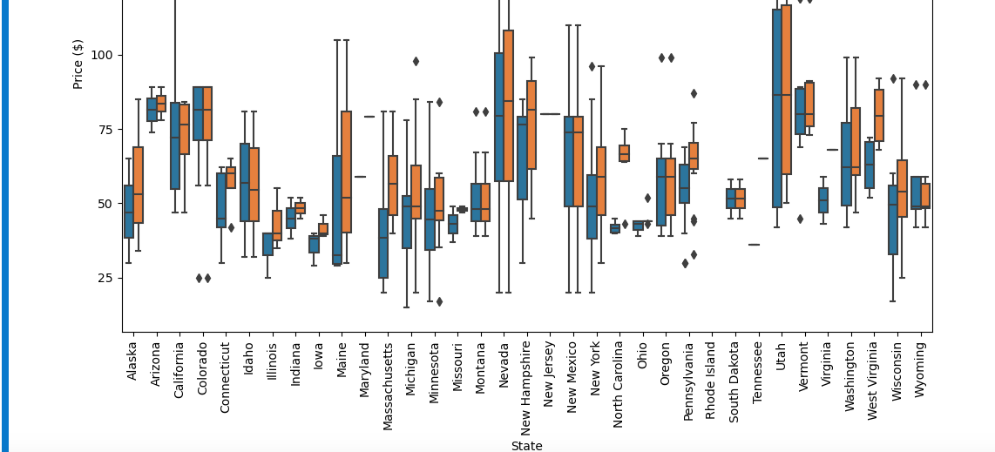
Price analysis across different states

Slide 3
Key Findings and suggestions:
About 16% of data is missing.
It would have been helpful to know the number of visitors the resorts get and the operating costs and other expenditures of each of the resorts.
The target variable was ‘AdultWeekend’ since the other ticket price had many more missing values
Big Mountain is a leader in Vertical drop, snow making area, number of chairs, fast quads, runs, longest run and skiable area
For any scenarios, the API to call in the model is predict_increase() which takes a feature and the numerical change on that feature, runs it through the model to predict the price change.
Scenario #2 offers the best solution based on this model. It allows for a $1.99 price change and $3.5M in revenue.
Another interesting finding from the model is, if there is a need to close the runs, it should be done one at a time or there will need to be a drastic change in ticket price.
The resort is in Montana where people value the features they get for the ticket price. This is the basis for the previous suggestion generated from the model

Slide 4
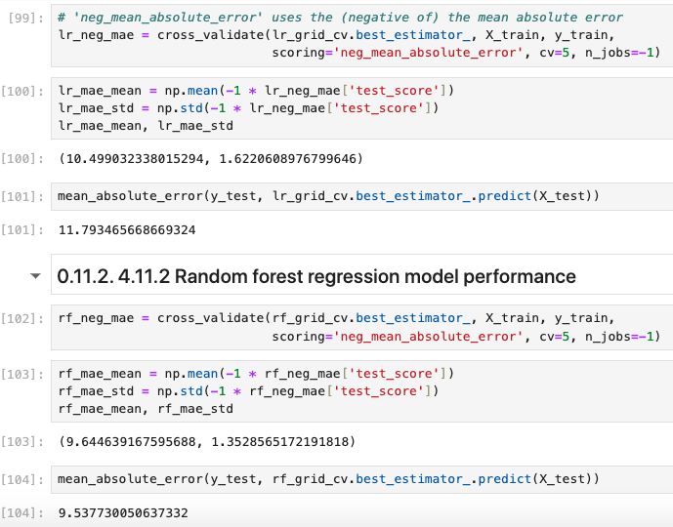
Model and Analysis - I
Why Random forest was chosen:
The Mean Absolute Error was much less
when compared with Linear regression.
The dominant top four features identified
which aligns with what we have seen in
other steps:
fastQuads, Runs, Snow Making_ac,
vertical_drop

Slide 5
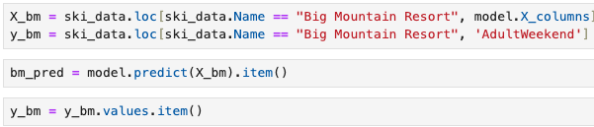
Model and Analysis - II
Using the model to predict the ticket price increase for Big Mountain suggested there is room to increase the price to about $95.
Even with a MAE of 10%, there is still room for price increase.

Slide 6
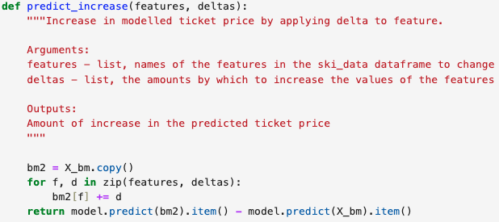
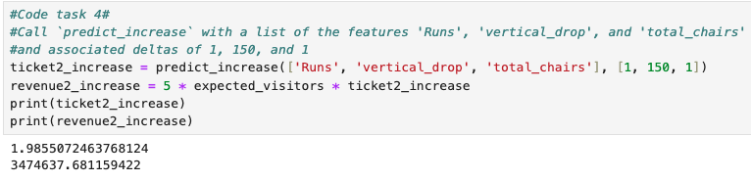
Model and Analysis - III
This is an important API
which will predict the ticket
price increase given a
list of features and numeric value
changes to those features.
For the scenario #2,
this is what the API projects:

Slide 7
Conclusion
Based on the model, scenario #2 is the best option among others considered.
In hindsight, it would have been good to know as part of the .csv, the number of visitors all resorts get each year, their operating cost and other expenses.
Any future project can be run through the model’s API ‘s to find profitability.

